Slide 1


Slide 2
Software Process and Project Metrics
By: Amina Mustansir
Lecturer, PUCIT

Slide 3

What is it?
Software process and product metrics are quantitative measures that enable software people to GAIN INSIGHT into the EFFICACY of the software process and the projects that are conducted using the process as a framework.

Slide 4

Areas of Application
Measurement can be applied to the software process
  With the intent of improving it on a continuous basis
Measurement can be used throughout a software project
  To assist in estimation, quality control, productivity assessment and project control.

Slide 5
Uses/Benefits
Measurements can be used by software engineers to
  Help assess the quality of technical work products.
  Assist in tactical decision making as a project proceeds
  Pinpoint problem areas

Slide 6
Roles-Who does it?
Analysis & Assessment
  Software managers
Collection of measures
  Software engineers

Slide 7
Why do we Measure? (Importance)
To characterize
  In an effort to gain understanding of processes, products, resources, and environments, and to establish baselines for comparison with future assessments
To evaluate
  To determine status with respect to plans
To predict
  Gaining understandings of relationships among processes and products and building models of these relationships
To improve
  Identifying roadblocks, root causes, inefficiencies and other opportunities for improving product quality and process performance

Slide 8
Importance (contd.)
In other words
  If you don’t measure, judgment can be based only on subjective evaluation.
  With measurement, trends (either good or bad) can be spotted, better estimates can be made, and true improvement can be accomplished over time.

Slide 9
Steps/ Procedures
Data collected
Measures often normalized
Analysis of result
Comparison against past result
Assessment
Conclusion drawn

Slide 10
A Good Manager Measures
process
process metrics
project metrics
measurement
product metrics
product
What do we
use as a
basis?
• size?
• function?

Slide 11
Measures
A measure provides a quantitative indication of the extent, amount, dimension, capacity, or size of some attribute of a product or process. [Pressman]
A basis for comparison; a reference point against which other things can be evaluated; "they set the measure for all subsequent work“ [Webster's Revised Unabridged Dictionary]
How much there is of something that you can quantify [Webster's Revised Unabridged Dictionary]

Slide 12
Measurement
Measurement is the act of determining a measure. [Pressman]
The act or result of measuring; as, measurement is required. [From The Collaborative International Dictionary of English v.0.48]
The extent, size, capacity, amount or quantity ascertained by measuring; as, its measurement is five acres. [From The Collaborative International Dictionary of English v.0.48]

Slide 13
Metric
A quantitative measure of the degree to which a system, component, or process possesses a given attribute [IEEE Standard Glossary of Software Engineering Terms[IEE93]]
A metric quantifies a characteristic of a process or product. Metrics can be directly observable quantities or can be derived from one or more directly observable quantities. [http://sunset.usc.edu/classes/cs577b_2001/metricsguide/metrics.html]
  Examples of raw metrics include the number of source lines of code, number of documentation pages, number of staff-hours, number of tests, number of requirements, etc.
  Examples of derived metrics include source lines of code per staff-hour, defects per thousand lines of code, or a cost performance index

Slide 14
Indicators
An indicator is a metric or combination of metrics that provide insight into the software process, a software project, or the product itself [RAG95]
  Process indicators
  Project indicators

Slide 15
Categories of measurements
2 categories of measurements:
  Direct measurement : measurement which does not depend on the measurement of any other attribute. SE process : cost, effort applied. Product : lines of code(LOC) produced, execution speed, memory size, defects reported over some set period of time.

Slide 16
Contd.
  Indirect measurement : measurement which involves the measurement of one or more other attributes. SE product : functionality, quality, complexity, efficiency, reliability, maintainability and many other “abilities”.

Slide 17
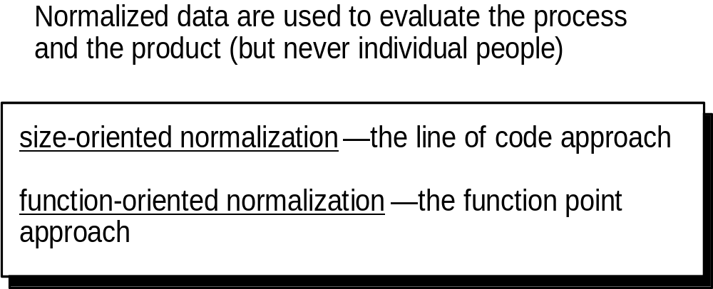
Normalization for Metrics

Slide 18
Size-Oriented Metric
(use LOC as normalized value)
Project | LOC | Effort | $(000) | Pp.doc. | Errors | Defects | People
alpha | 12,100 | 24 | 168 | 365 | 134 | 29 | 3
beta | 27,200 | 62 | 440 | 1224 | 321 | 86 | 5
gamma | 20,200 | 43 | 314 | 1050 | 256 | 64 | 6
- | - | - | - | - | - | - | -
- | - | - | - | - | - | - | -

Slide 19

Size oriented metrics
Proponents claim
  Easily counted
  LOC as input
  Data already exists
Opponents argue
  Depend on programming language
  Penalize well-designed but short program
  Cannot easily accommodate nonprocedural languages.

Slide 20
Typical Size-Oriented Metrics
errors per KLOC (thousand lines of code)
defects per KLOC
$ per LOC
page of documentation per KLOC
errors / person-month
LOC per person-month
$ / page of documentation

Slide 21
Create three-point or expected value estimate
Optimistic values for size
Most likely values for size
Pessimistic values for size
S=(s_{opt}+4s_{m}+s_{pess})/6
Where S = the expected value for the estimation variable(size)

Slide 22
Optimistic values | Most likely | Pessimistic values | Est. LOC
23 | 24 | 30 | 24.8
50 | 54 | 59 | 54.17
101 | 105 | 108 | 104.83
 |  | Total LOC | 183.8

Slide 23
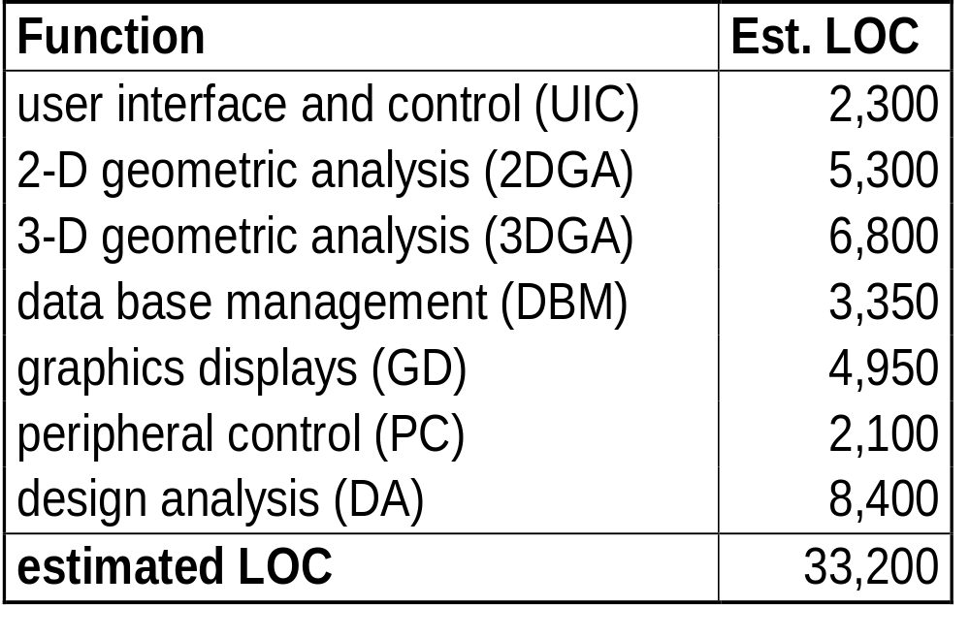
Example of LOC-Based Estimation
Range of LOC estimates for the 3D geometric analysis function is optimistic-4600 LOC, most likely-6900 LOC, and pessimistic-8600 LOC

Slide 24
Organizational average productivity=620 LOC/pm
Labor rate = $8000 per month
Estimated effort = ?
Total Estimated Effort = LOC est. / prod.
Cost/LOC = ?
Cost / LOC = labor rate / prod.
Total cost = ?
Total Project Cost = LOC est. * (cost / LOC)

Slide 25
Function-Oriented Metrics
Uses a measure of the functionality
  – inputs, outputs, files, inquiries, Interfaces
Indirectly derived
Function point
  scaled by simple, average, complex

Slide 26
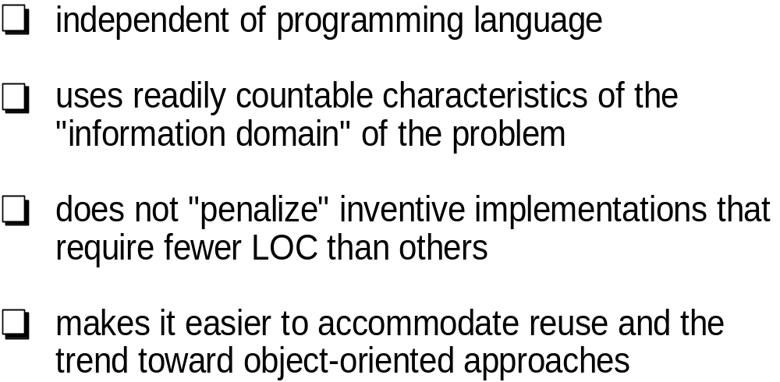
Why Opt for FP Measures?

Slide 27
Typical Function-Oriented Metrics
errors per FP (thousand lines of code)
defects per FP
$ per FP
pages of documentation per FP
FP per person-month

Slide 28
Computing Function Points
Analyze information
domain of the
Establish
count
for input domain and
application
system interfaces
and develop counts
Weight each count by
Assign level of complexity or
weight
assessing complexity
to each count
Assess influence of
Grade significance of external factors, F
global factors that affect
i
such as reuse, concurrency, OS, ...
the application
Compute
function points
FP = Count Total * [ 0.65 + 0.01 * (Fi)]

Slide 29
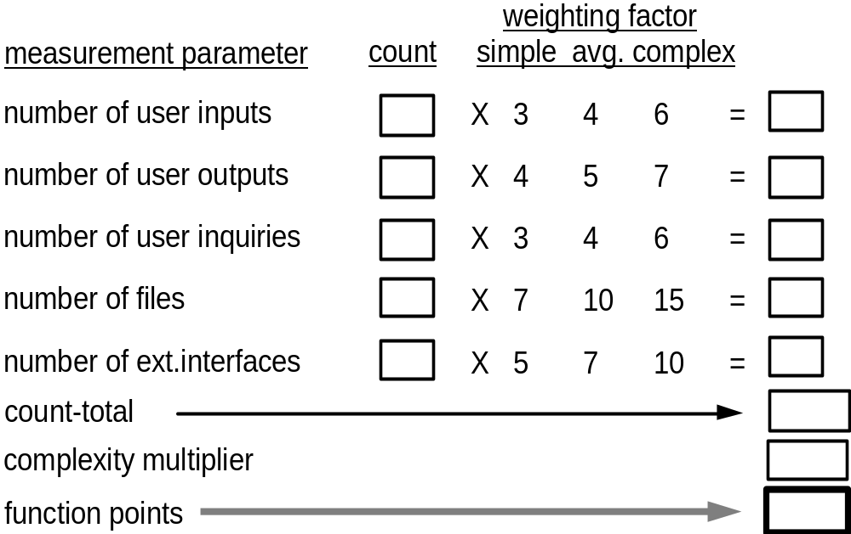
Analyzing the Information Domain

Slide 30
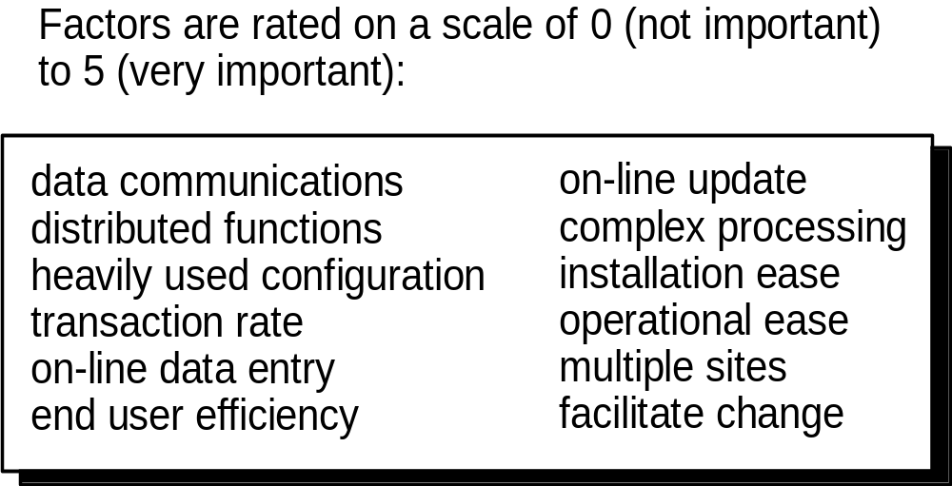
Taking Complexity into Account

Slide 31
Apply the following formula
  Fp_{estimated}=count-total*[0.65+0.01* Σ(Fj)]

Slide 32
Example of FP-Based Estimation
Information domain value
Optimistic
Most Likely
Pessimistic
Number of inputs
20
24
30
Number of outputs
12
15
22
Number of inquiries
16
22
28
Number of files
4
4
5
Number of external interfaces
2
2
3

Slide 34
Information domain value
Estimated count
Weight
FP count
Number of inputs
24
4
97
Number of outputs
16
5
78
Number of inquiries
22
4
88
Number of files
4
10
42
Number of external interfaces
2
7
15

Slide 35
Factor
Value
Backup and recovery
4
Data communication
2
Distributed processing
0
Performance critical
4
Existing operating environment
3
On-line data entry
4
Input transaction over multiple screens
5
Master files updated on-line
3
Information domain values complex
5
Internal processing complex
5
Code designed for reuse
4
Conversion/installation in design
3
Multiple installations
5
Application designed for change
5
Total
52

Slide 36
Fp_{estimated}=count-total*[0.65+0.01* Σ(Fj)]
Fp_{estimated}=372
Organizational average productivity=620 FP/pm
Labor rate = $8000 per month
Estimated effort = ?
Total Estimated Effort = FP est. / prod.
Cost/FP = ?
Cost / FP = labor rate / prod.
Total cost = ?
Total Project Cost = FP est. * (cost / FP)

Slide 37
Measuring Quality
Correctness — the degree to which a program operates according to specification
Maintainability—the degree to which a program is amenable to change
Integrity—the degree to which a program is impervious to outside attack
Usability—the degree to which a program is easy to use

Slide 38
Defect Removal Efficiency
DRE = (errors) / (errors + defects)
where
errors = problems found before release
defects = problems found after release

Slide 39
Size Estimating Principles
Estimating is an uncertain process
No one knows how big the product will be
The earlier the estimate, the less is known
Estimates can be biased by business and other pressures
Estimating is an intuitive learning process
Ability improves with experience
Some people will be better at estimating than others

Slide 40
Estimating is a skill
Improvement will be gradual
You may never get very good at the start
The objective, however, is to get consistent
You will then understand the variability of your
estimates
You seek an even balance between under and over estimates

